Slide 1
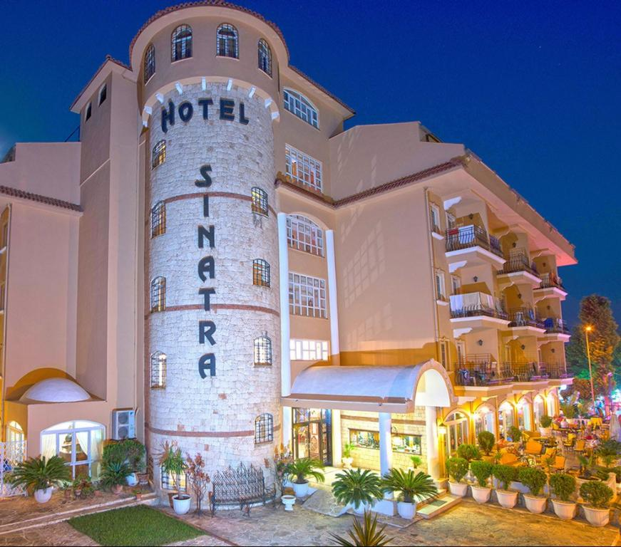
HOTEL SINATRA SUSTAINABILITY REPORT | YEAR 2025

Slide 2





HOTEL SİNATRA
GENERAL OPINION
Çamyuva, Turizm Blv., 07980 Kemer/Antalya
+90 242 524 53 45
+90 242 8245016
Web Cite : https://hotelsinatra.com/
E-Mail : info@hotelsinatra.com

Slide 3
DİSTANCES
Kemer | : 7 km
City Center | : 60 km
Antalya Airport | : 65.91 km

Slide 4
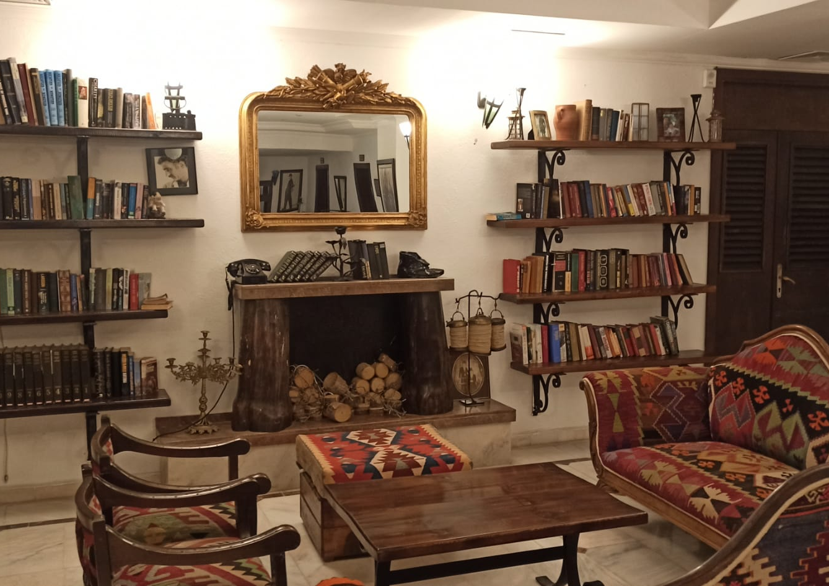
HOTEL SINATRA
Opened in the summer season of 1998. The entire hotel was last completely renovated in 2005.
Our hotel, with its natural beauty, atmosphere, and proximity to historical sites, perfectly reflecting the mystical atmosphere of the Mediterranean, will be your first choice.

Slide 5
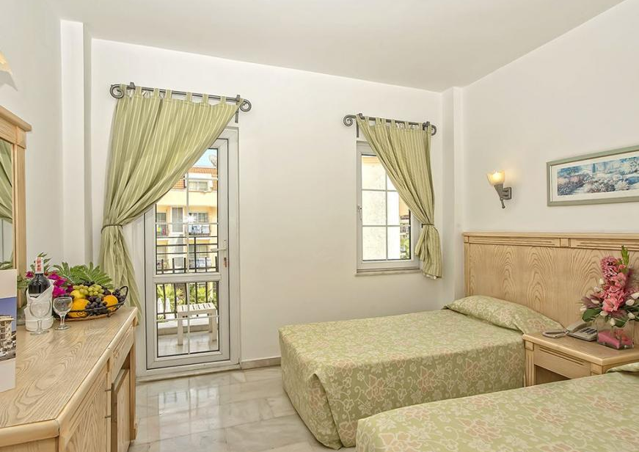
STANDARD ROOM
The hotel has a total capacity of 162 beds, including 81 standard rooms.
Our hotel has 67 standard rooms, each measuring 14 square meters. Our standard rooms offer mountain views. Room features are as follows:
• Balcony
• Split air conditioning
• Wardrobe
• Bathroom, Shower cabin
• Hair dryer
• Direct dial telephone
• Satellite TV
• Minibar
• Music broadcast
• Safe deposit box available.

Slide 6
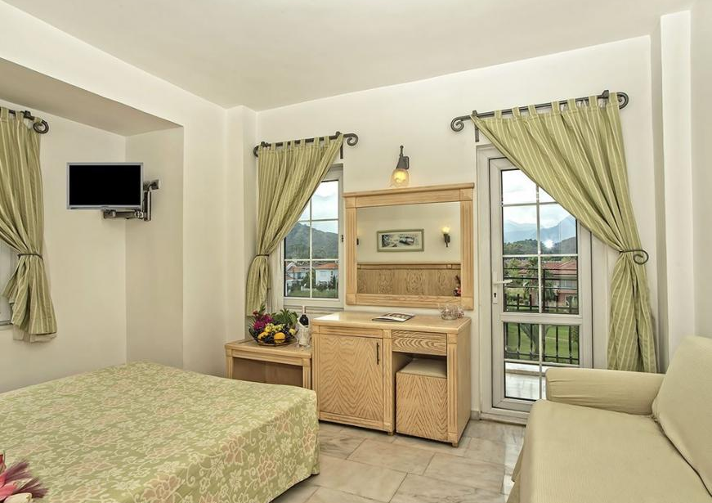
CORNER ROOM
• Balcony
• Split air conditioning
• Wardrobe
• Bathroom, Shower cabin
• Hair dryer
• Direct dial telephone
• Satellite TV
• Minibar
• Music broadcast
• Safety deposit box available.

Slide 7
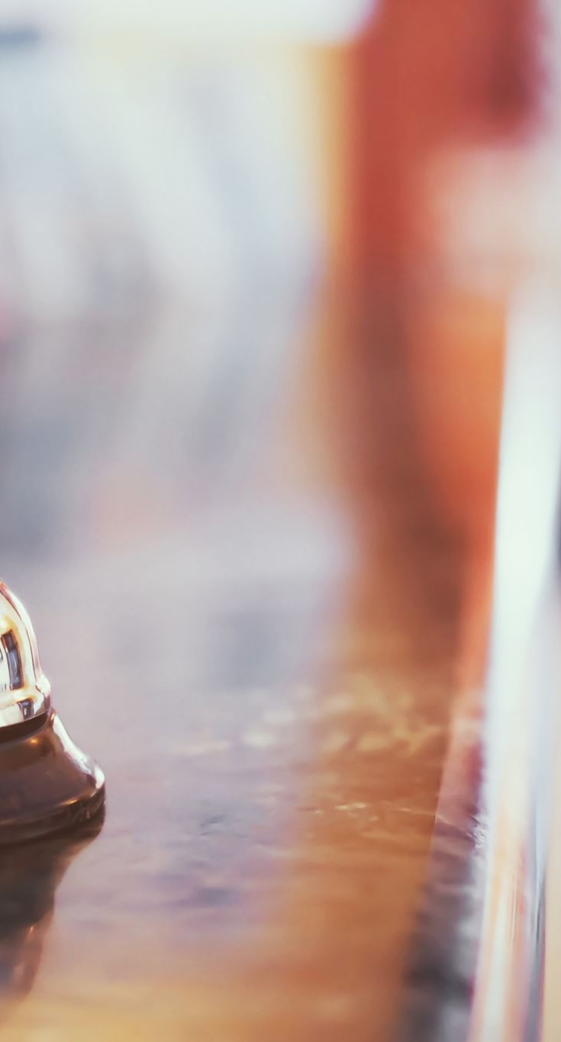
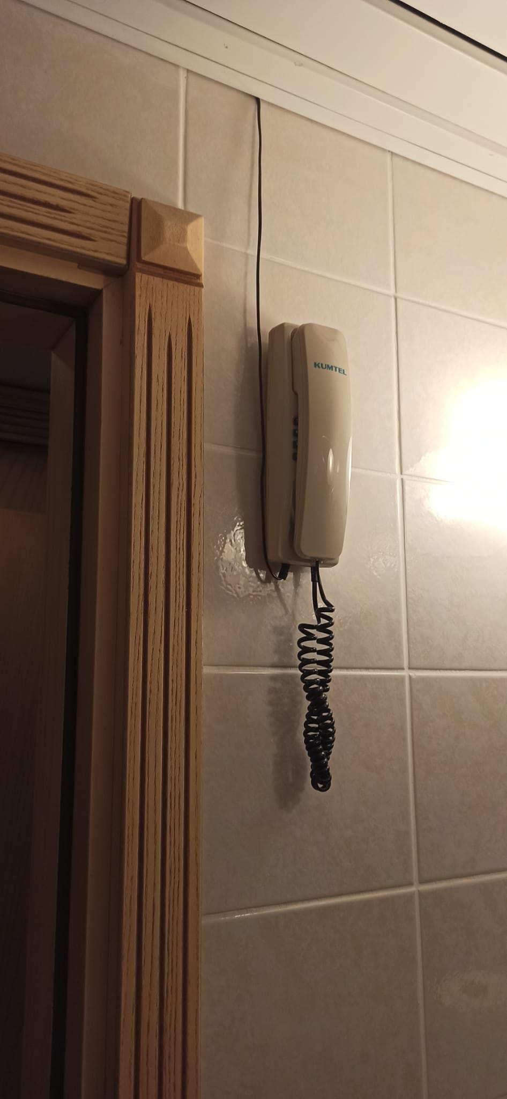
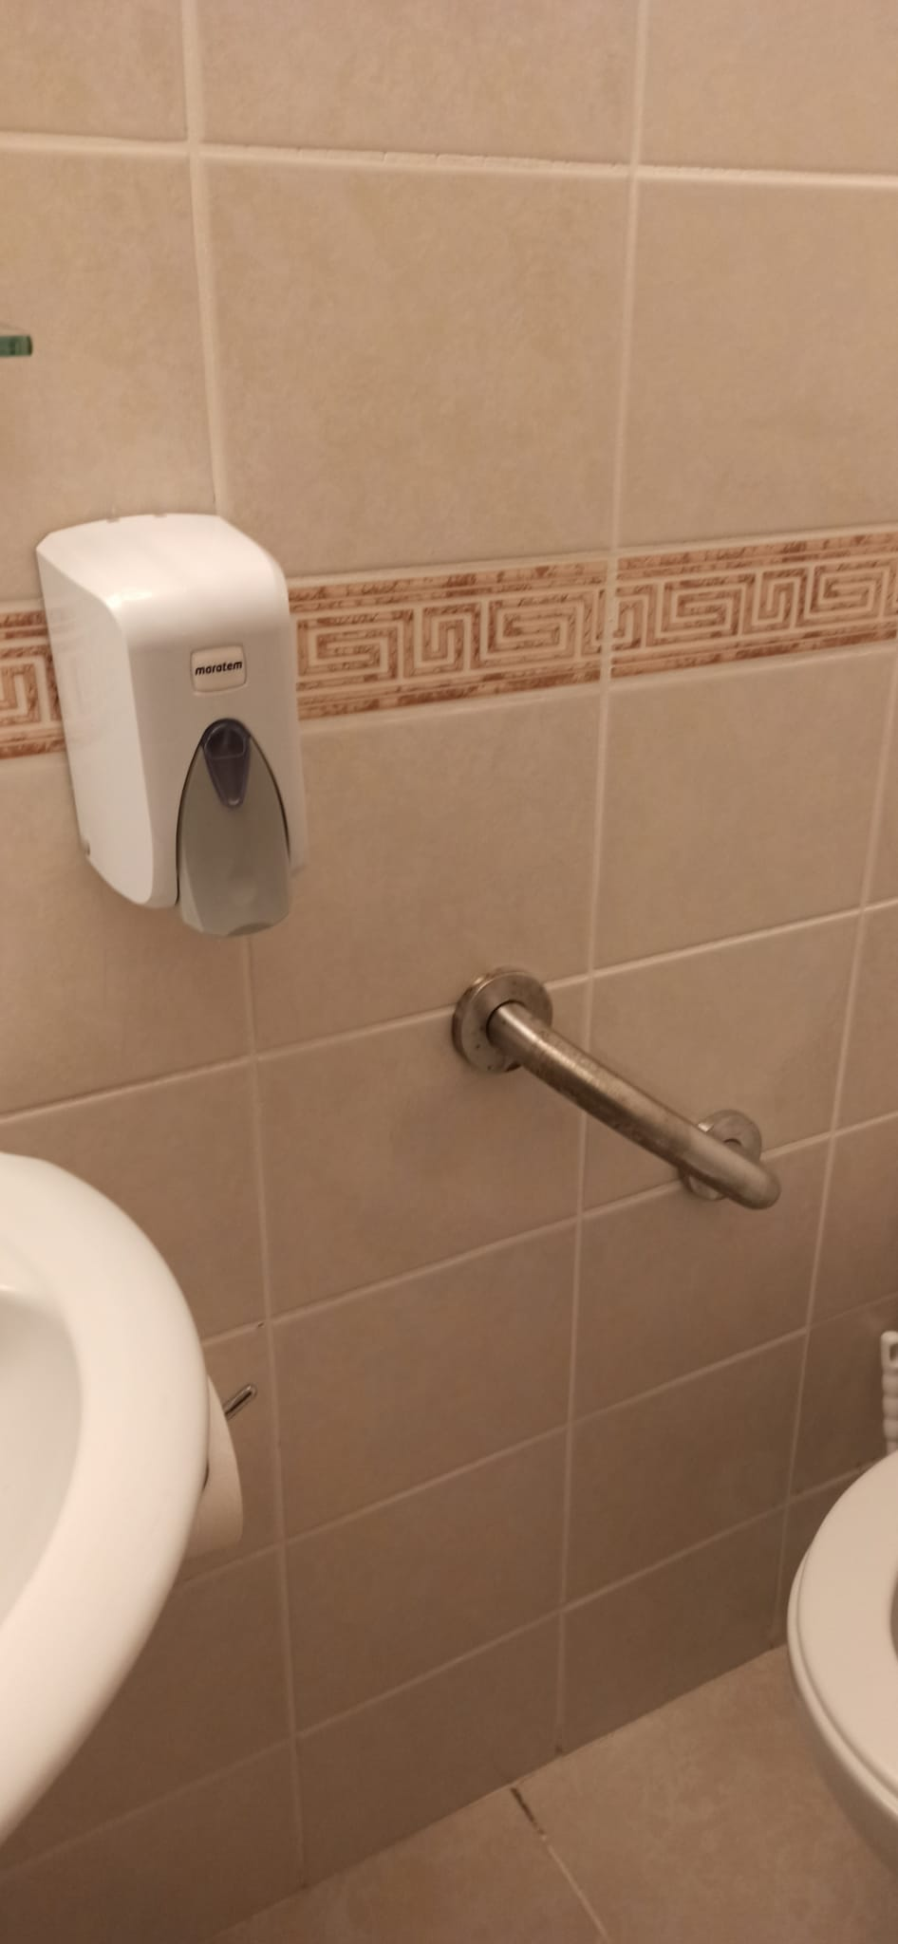
HOTEL ACCESSIBILITY
DISABLED ROOM
There is 1 disabled room available.

Slide 8
POLICY
While providing our guests with a sustainable accommodation experience, our company adopts it as a core responsibility to comply with all national legislation and the legal requirements set by the relevant authorities of our country during all activities we offer. Together with our employees, who have been with us since the establishment of our company, we act with a strong team spirit to protect human health and human rights, and to fulfill the necessary conditions to ensure a safe and healthy working environment.
We aim to establish a bridge between our business and the surrounding community, institutions, and natural habitats, with the objective of maintaining positive and sustainable partnerships.Within the scope of occupational health and safety activities, we conduct analyses at our facility to ensure the safety of our employees, local partners, and stakeholders, and take the necessary actions to prevent practices that may pose risks to health. Acting in accordance with these principles is embraced as part of our corporate culture.
We adopt a zero-tolerance approach to the protection and safeguarding of children. We ensure that every child within our premises is protected against all forms of abuse.We are committed to raising environmental awareness among our suppliers and all stakeholders, encouraging mutual development, learning, and increased awareness. Together with our business partners and guests, we aim to enhance awareness and consciousness through collaboration.
Along with our employees, we strive to ensure continuous development and awareness while also keeping per capita energy and water consumption under control, preventing waste by developing and implementing various conservation measures, and increasing our training and service standards. These objectives form an integral part of our sustainability policy.While continuing all these activities, our company commits to promoting environmental sensitivity by increasing awareness of sustainable tourism and fostering individual responsibility.
By maintaining communication and cooperation with the region in which we operate, we aim to create shared benefits for the local community. In this context, we support sustainable tourism policies and invite our employees and guests to understand our policy, share it with the communities they live in, and implement it together.

Slide 9
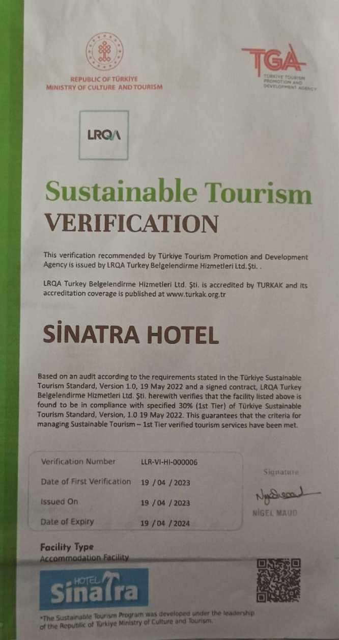
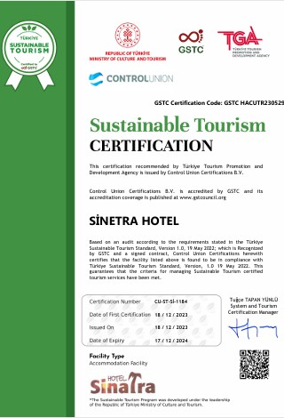
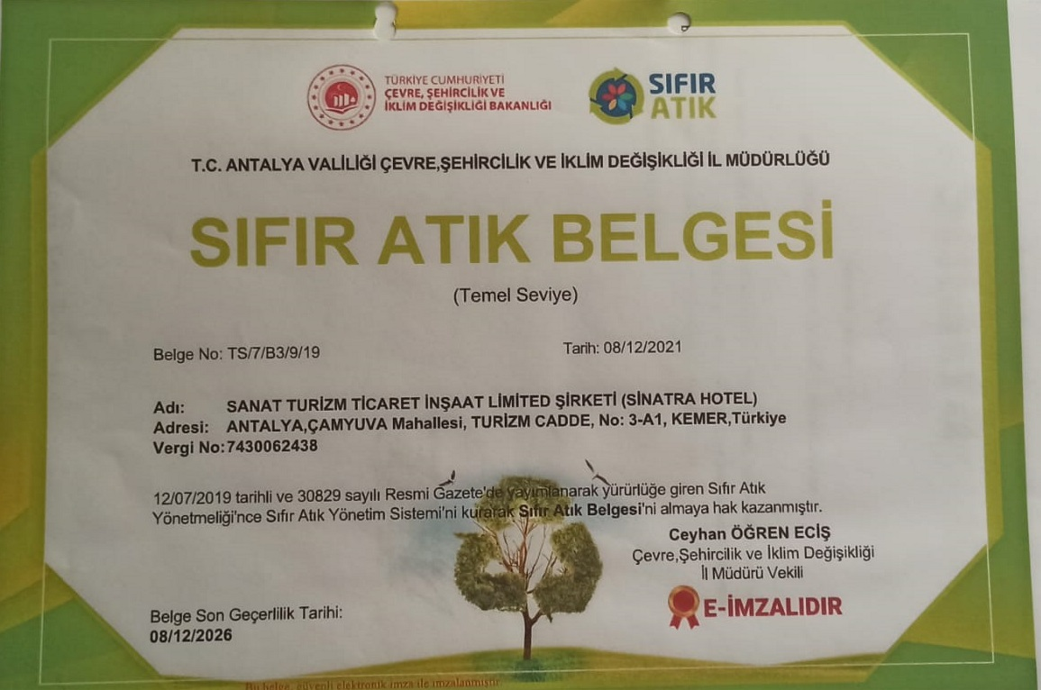
We have zero waste certification and sustainability certifications, and we monitor their validity.

Slide 10
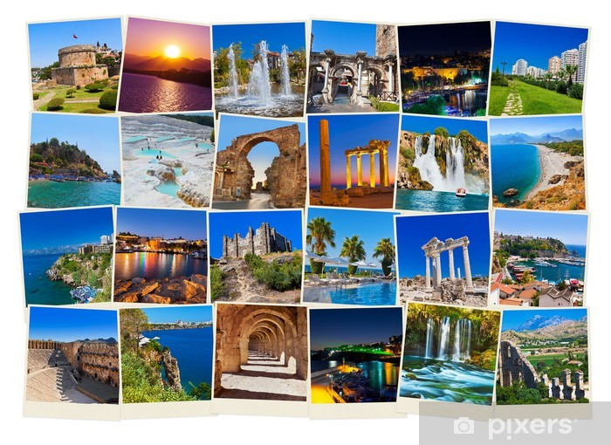
Phaselis Antik Kenti 3.68 km.Olimpos ( Olympos ) Örenyeri 19.98 km.Rhodiapolis Antik Kenti 32.63 km.Phaselis Müzesi 3.53 km.
Phaselis Antik Kenti 3.68 km.Olimpos ( Olympos ) Örenyeri 19.98 km.Rhodiapolis Antik Kenti 32.63 km.Phaselis Müzesi 3.53 km.
Phaselis Ancient City 3.68 km.
Olympos Archaeological Site 19.98 km.
Rhodiapolis Ancient City 32.63 km.
Phaselis Museum 3.53 km.
Antalya State Opera and Ballet Hall 40.17 km.
Kumluca Sarnıç Tepesi Zoo 31.9 km.
Akyarlar Cave 25.03 km.
We are at this distance...

Slide 11





OUR UNESCO REGISTERED FOODS
ADANA KEBAP
AYRAN
BAKLAVA
ÇİĞ KÖFTE
EZİNE PEYNİRİ
MANTI
PATLICAN KEBABI
PİYAZ
TULUM PEYNİRİ
ZEYTİNYAĞI

Slide 13
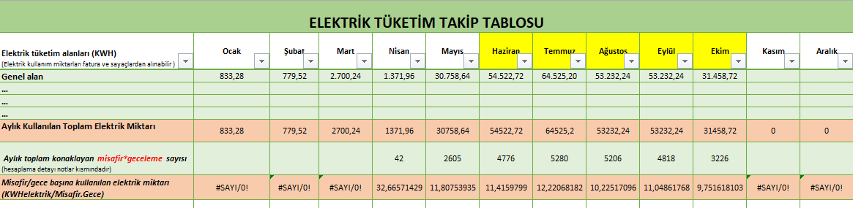
ELECTRICITY CONSUMPTION IN 2025
Electricity consumption data for 2025 has been regularly monitored, analyzed, and reported in line with sustainable energy management goals.

Slide 14
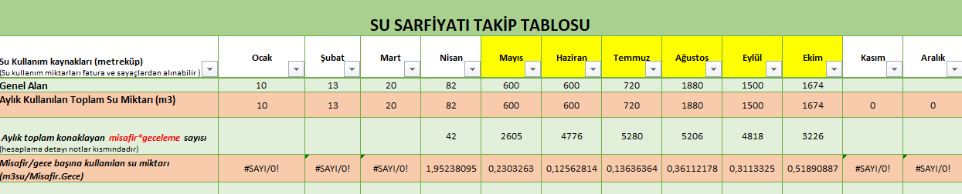
WATER CONSUMPTION IN 2025
Water consumption data for 2025 has been regularly monitored, analyzed, and reported in line with sustainable energy management goals.

Slide 15
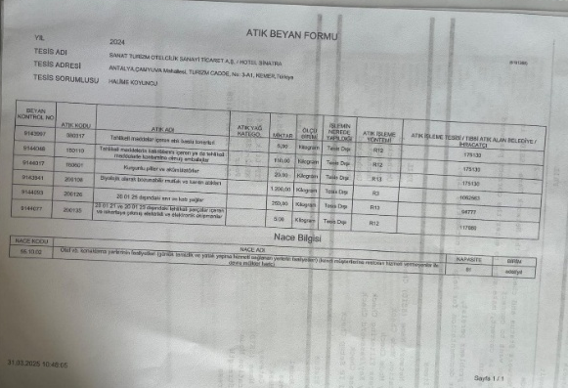
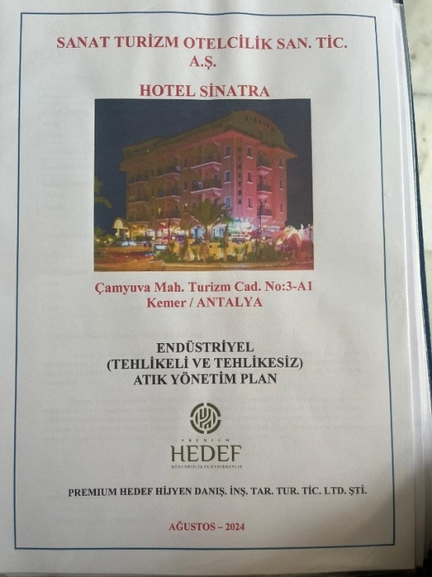
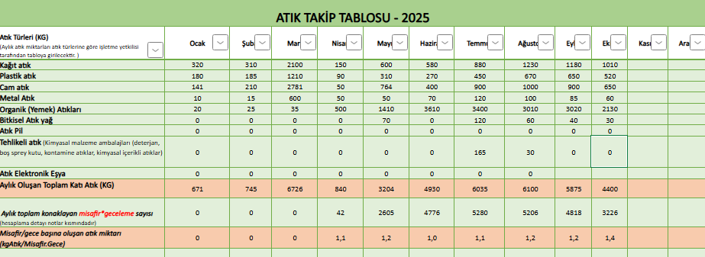
WASTE CONSUMPTION IN 2025
The amount of waste generated within the scope of our waste management plan is regularly monitored and recorded in coordination with our environmental consulting firm.

Slide 16
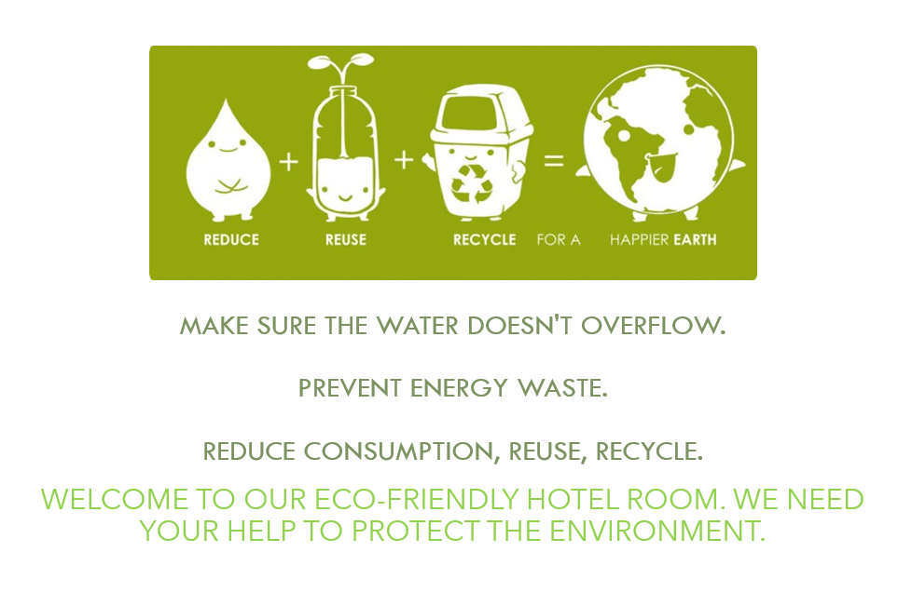
The aim was to increase employee awareness by using informative stickers and visual guidance in relevant areas throughout the facility.

Slide 17

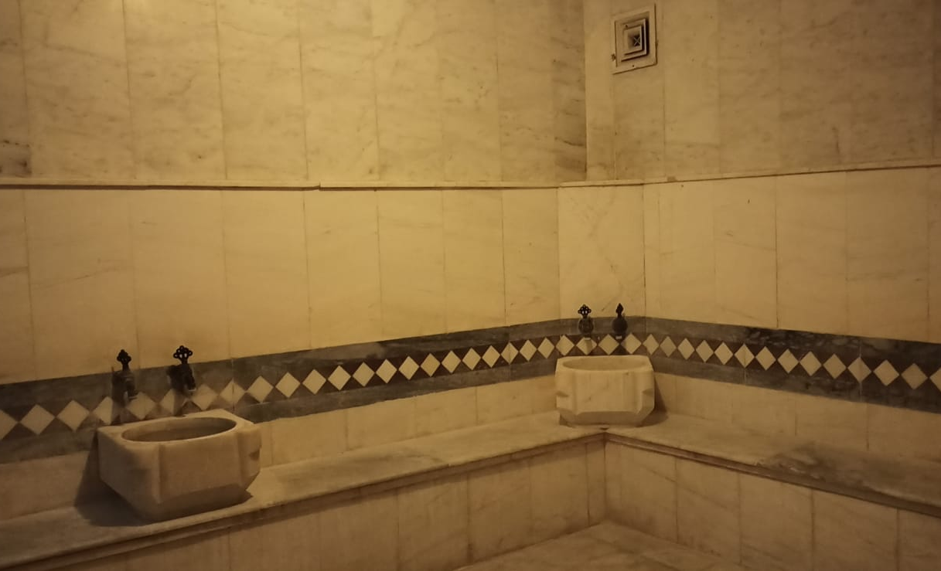



From the Ottoman Era to the Present Day
Turkish Bath Culture
The facility includes a traditional Turkish bath, which is available as part of the social and relaxation areas.

Slide 18
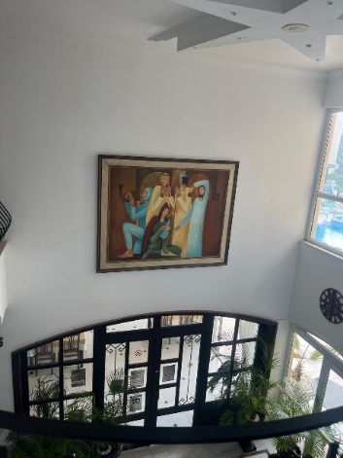
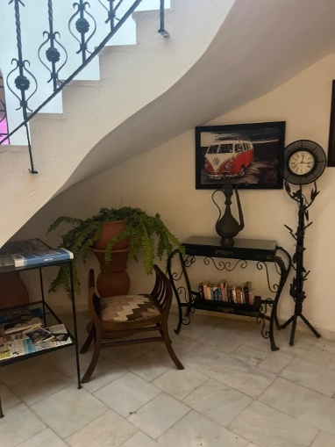
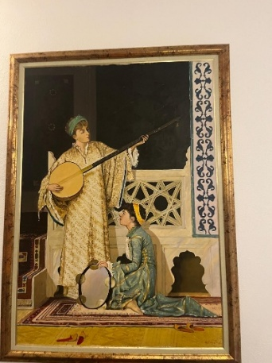
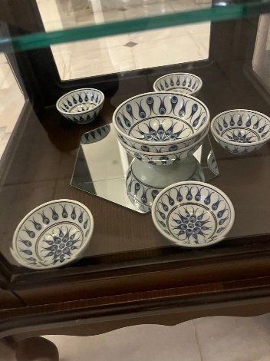
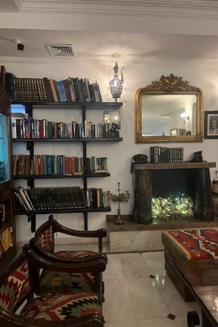
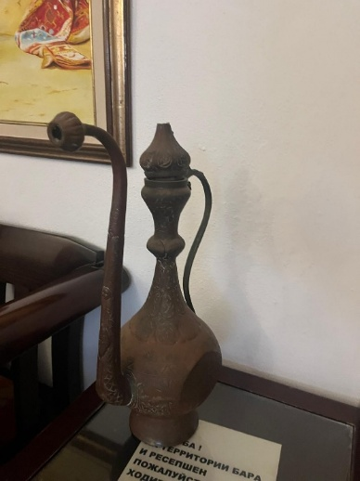
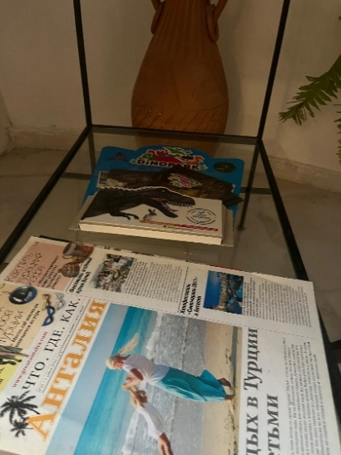
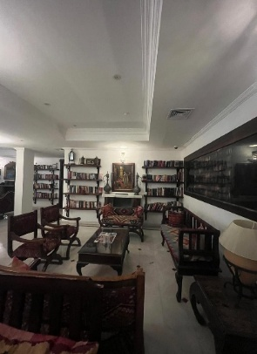
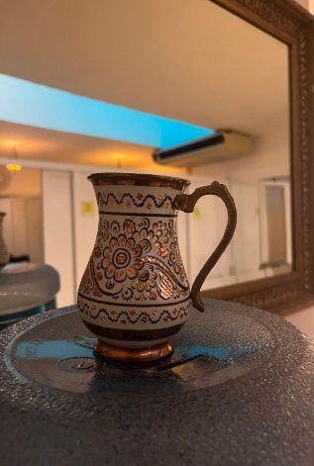
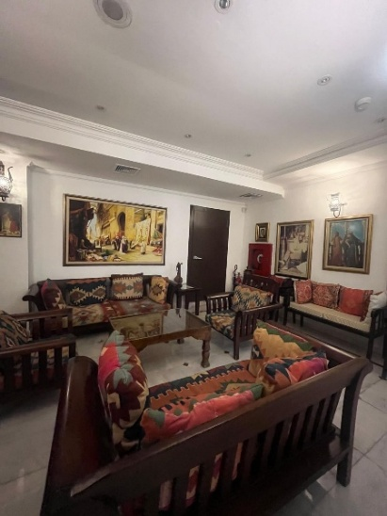
Throughout the facility, antique and ethnographic objects reflecting Turkish culture are displayed with the aim of preserving cultural heritage and strengthening spatial identity.

Slide 19

THE PLANTS WE USE IN LANDSCAPING ARE DROUGHT-RESISTANT PLANTS THAT REQUIRE LITTLE WATERING. IN THIS WAY, WE ALSO DRAW ATTENTION TO WATER CONSERVATION.
Areca Palm
Geranium
Dwarf Pine
Rosette Flower...

Slide 20

CODE OF CONDUCT IN PLACES SUBJECT TO CULTURAL HERITAGE IN TURKEY
In order to protect the cultural heritage areas in Turkey and pass them on to future generations, please comply with the following rules.
At the entrances of places of worship; Wearing clothing that exposes the knees and shoulders, such as shorts and skirts, and speaking loudly and listening to music are prohibited in sacred places.
Please ask permission to take photos and videos with children and people you do not know. Shooting without permission is prohibited.
In areas where monuments and historical artifacts are located, it is prohibited to sit and lean on carved and fragile surfaced artifacts and monuments.
Consumption of alcohol and cigarettes is prohibited in areas where smoking is prohibited.

Slide 21
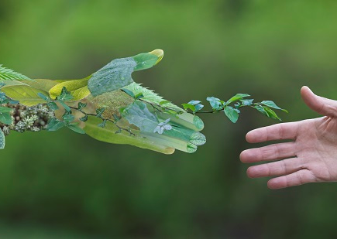
JOIN US ON THE SUSTAINABLE TOURISM JOURNEY.

